Slide 1
Homework 2
Team 1
Apostolopoulou Ioanna
Toloudis Panagiotis

Slide 2
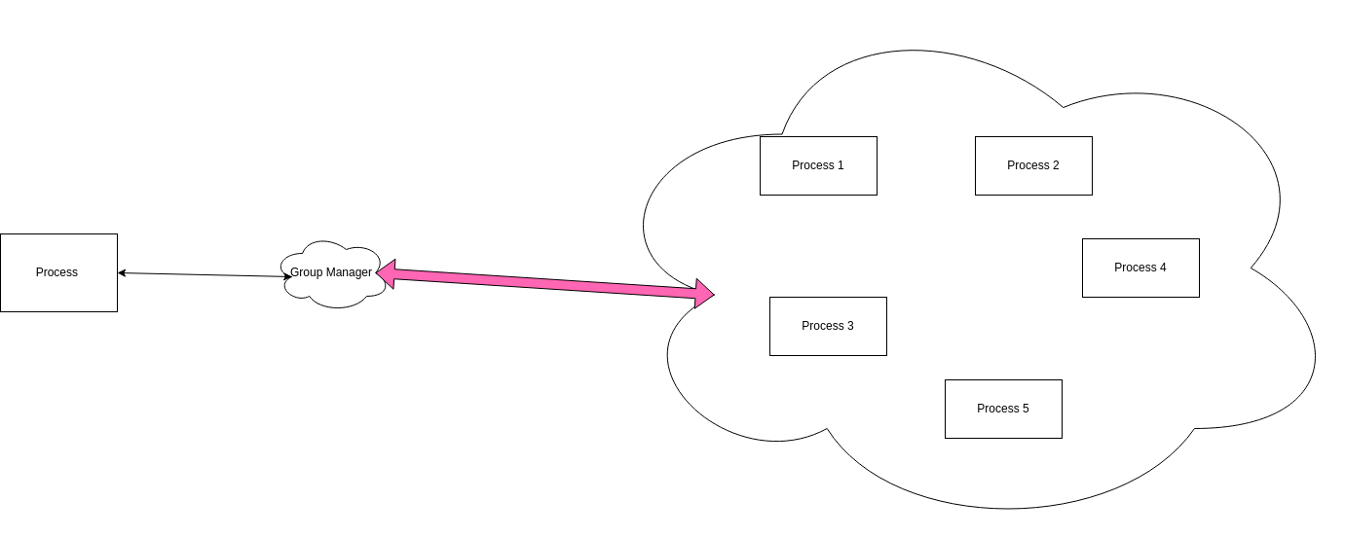
Start

Slide 3
Basic Stuctures
When a new process is created and wants to join a group, it uses multicast to discover the Group Manager.
Processes have one TCP socket to communicate with the Group Manager and one UDP socket to discover the Group Manager and exchange messages in the Group.
Group Manager has also one TCP socket to communicate with processes who want to join or leave the Group and one UDP socket to reply to Multicast done for discovery.

Slide 4
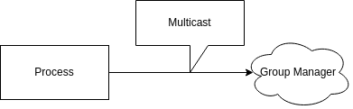

MULTICAST
Multicast Send
Unicast Resive

Slide 5
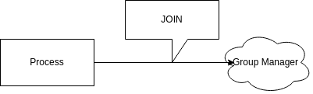
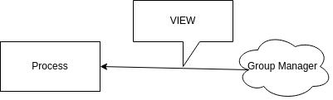
Join in Group
Join in Group Request
GM Send View
VIEW:
If Join: Send IP, Port and Name from all in the Group
Else: NOT

Slide 6
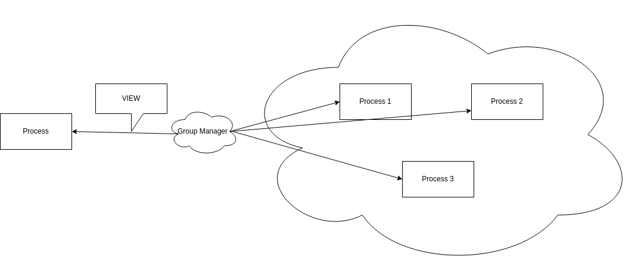
Send Update in Group

Slide 7
Join & Update Group
When process finds Group Manager from Multicast, a communication between Process and Group Manager begins by using a TCP/IP connection.
Process sends a join request at Group Manager, that contains the Process Name, its IP adrress, its Port and the Group Name to join.
Group Manager receives the request and sends to process a reply containing the view of the group and informs all other processes in group by sending the contact information for the newly joined process.

Slide 8
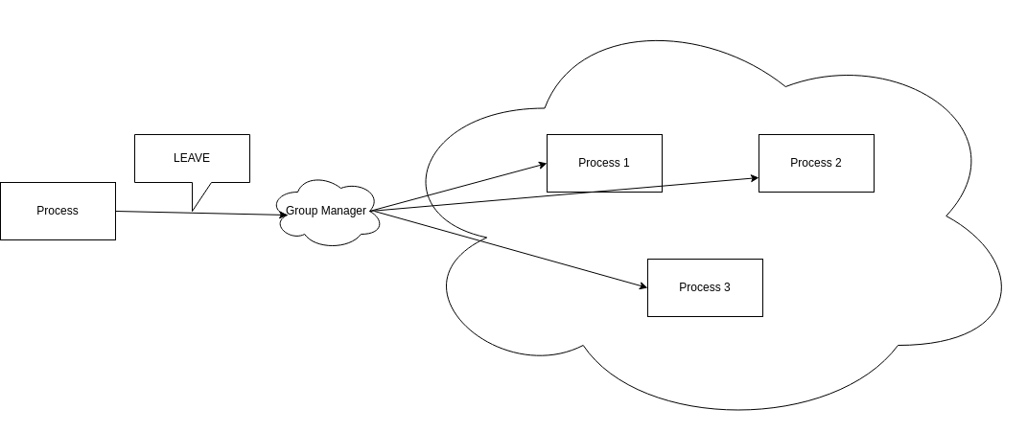
Leave in Group

Slide 9
Leave & Update Group
When a Process wants to leave the Group or a node has a damage, the Group Manager and Process reuse their previous TCP/IP connection for communication.
Process sends a request to leave Group at the Group Manager.
Group Manager removes process from Group and informs the other processes in Group for the Changes in the dynamics of the Group.

Slide 10
FIFO Order

Slide 11
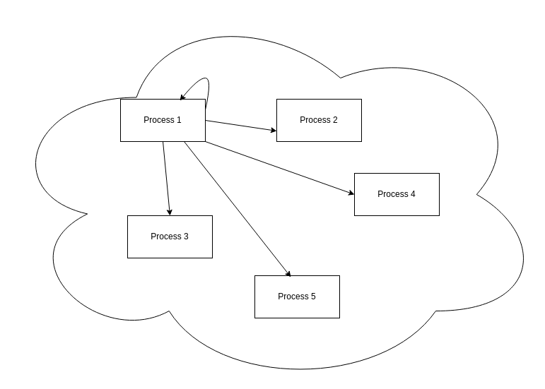
Send with FIFO

Slide 12
Fifo Order
When Process in Group sends a message using catoc parameter as 0, messages in group are delivered in Fifo Order.
When message arrives in process it is stored in a buffer. Process sends the first stored message into application and continues to send next messages by compairing their sequence number.

Slide 13
Example Fifo Order

Slide 14
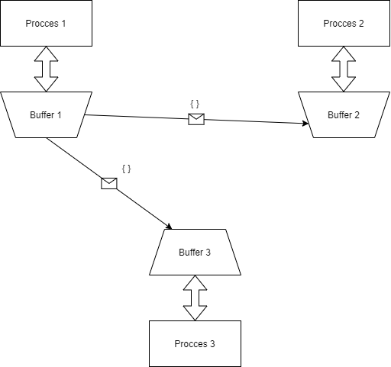

Slide 15
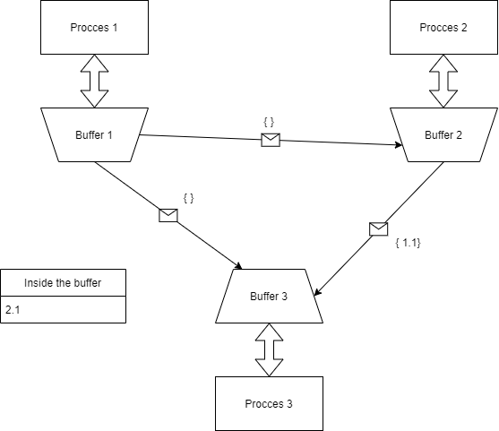

Slide 16
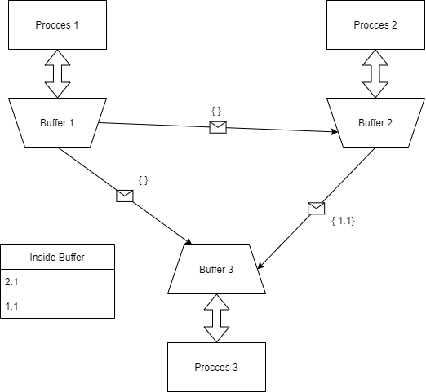

Slide 17
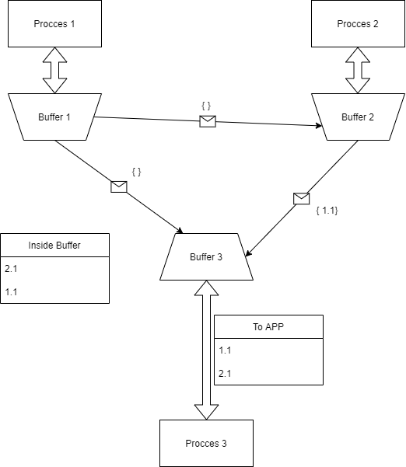

Slide 18
Causal-Total Order

Slide 19
Send with CATOC

Slide 20

VOTE RECIVE

Slide 21
Max Vote

Slide 22
Causal Total Order
When a process wants to send message in group with CATOC Order should give catoc parameter the number 1.
When message arrives in process it is stored in a buffer.
We are using a Symmetric protocol that each process in Group when a message is stored in its buffer send back to sender a vote to determine the priority each message has in buffers.
Each message is delivered to the applcation in order determined by the voting process, so the causality of the messages is ensured.
When one process sends simultaneously n messages causality is broken so we are using a mutex to block each process from sending n messages before the first is delivered to the application.

Slide 23
Example CATOC Order

Slide 24
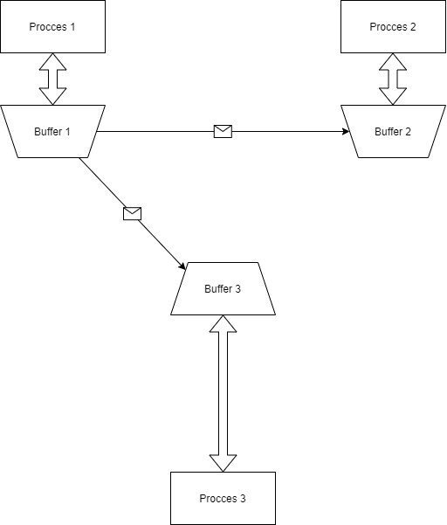

Slide 25
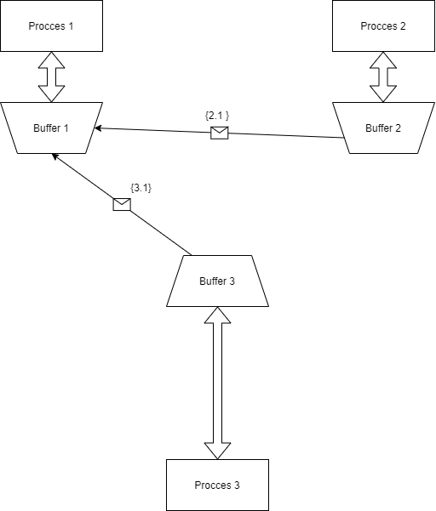

Slide 26
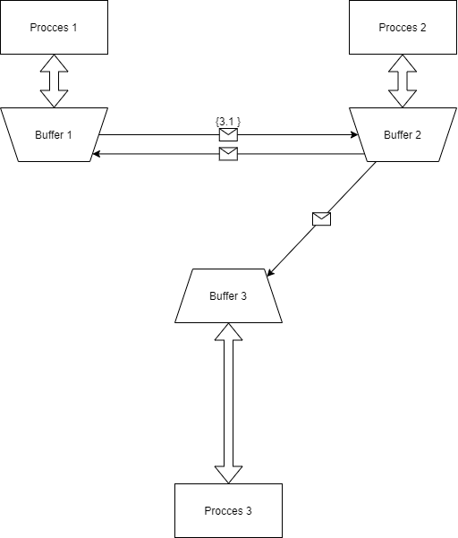

Slide 27


Slide 28


Slide 29
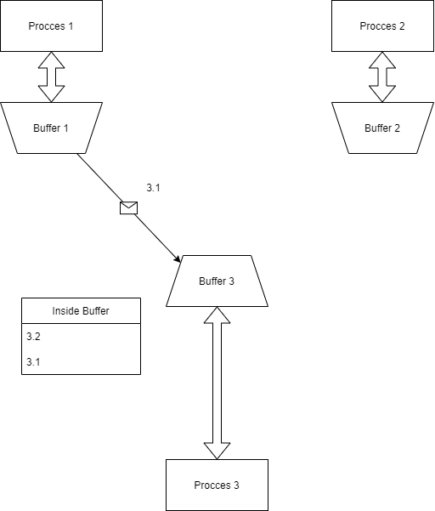

Slide 30
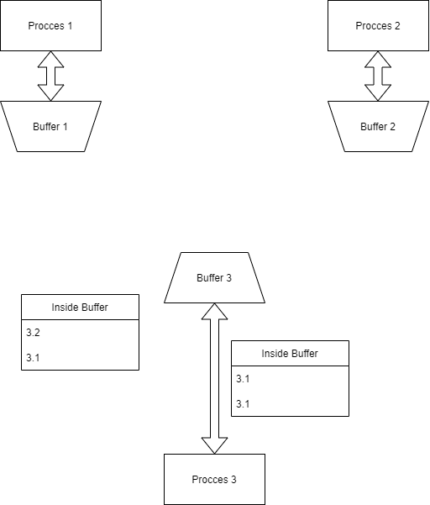

Slide 31
The End !!!

